Slide 1
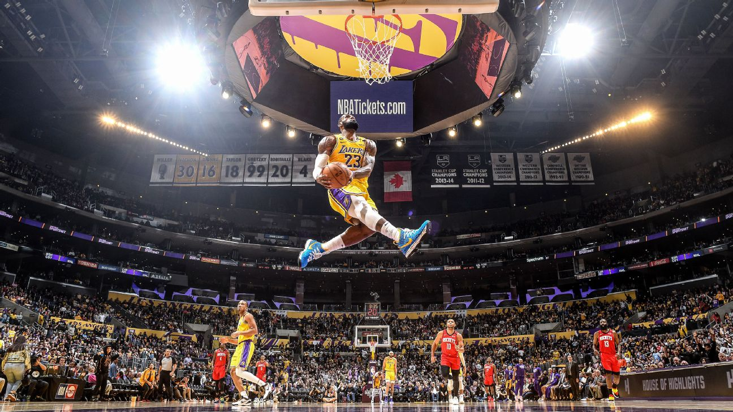
NBA Player Clustering 2019-2020 NBA Season Tony Ramsett Data Practicum 2 Regis University

Slide 2



Project Description
Research Question
Data sets Used
Models Utilized
How were NBA players similar and different from a statistical perspective before COVID-19 forced the season to shut down?
Three data sets used from basketball-reference.com
Shooting Statistics
One data set from NBA.com
Traditional (Box Score) Statistics
Advanced Statistics
Defensive Statistics
Unsupervised Learning Models
K-Means Clustering
Hierarchical Clustering Analysis (HCA)

Slide 3
Project Timeline
8-week project spanning from 06/28/20 – 08/23/20 followed the Data Science Lifecycle
Week 1
Week 2
Week 3
Week 4
Week 5
Week 6
Week 7
Week 8
Business Understanding
Data Mining
Data Cleaning
Data Exploration
Feature Engineering
Predictive Modeling
Data Visualization

Slide 4




Unsupervised Learning
Examples of unsupervised Learning
What is it?
fff
Kmeans – what is it/why important
HCA – what is it/why important
PCA – what is it/why important
Others out there …
Significance/Purpose
Disadvantages of unsupervised learning
fff
fff

Slide 5
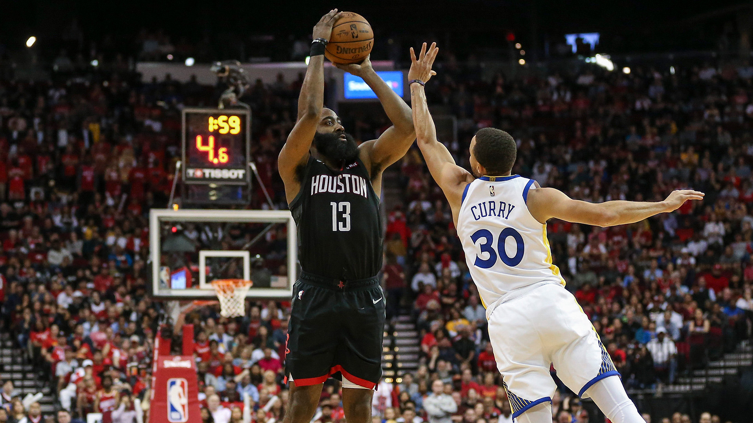
Offensive Scoring Clusters

Slide 6
Data Description
Variables – what is it – list out
Then
Note which variables used/removed/subset/data cleaning

Slide 7
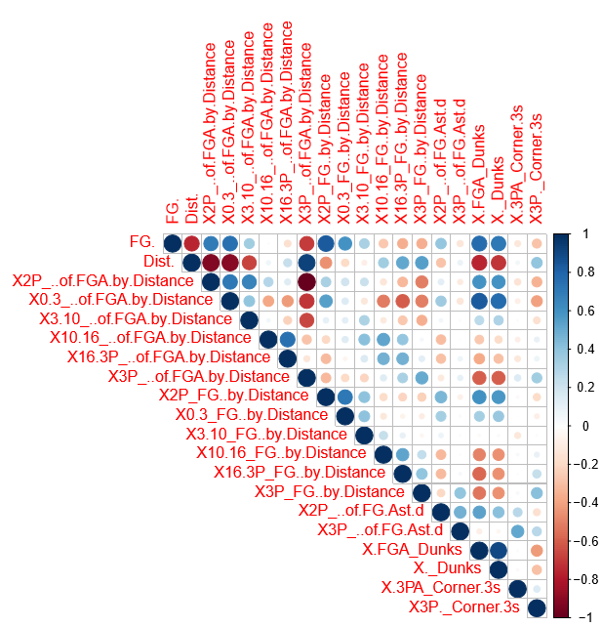
Corrplot
Takeaways
Takeaways

Slide 8
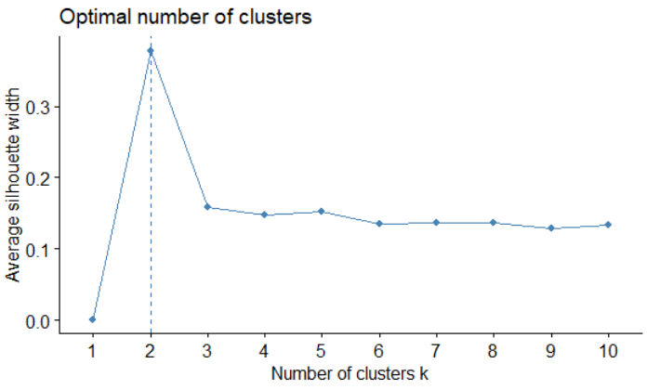
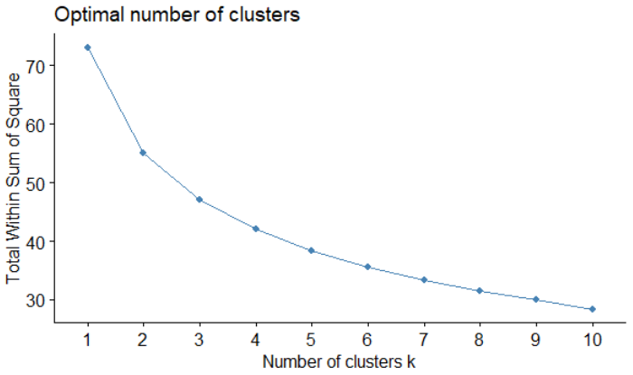
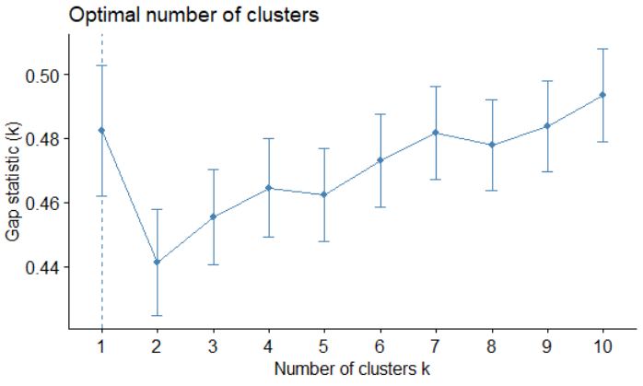
Cluster Outputs
Determine which cluster size to use …
Tagish line – describe different methods
Elbow Method
Silhouette Method
Gap Statistic Method
explain method
explain method
explain method
Total clusters and why----

Slide 9
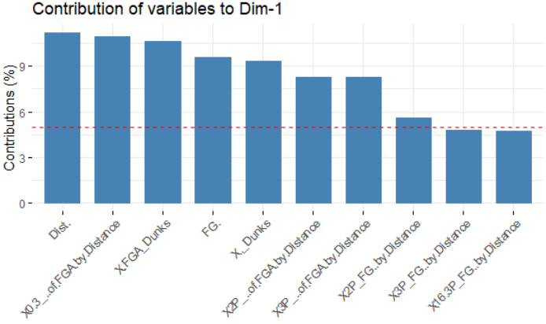
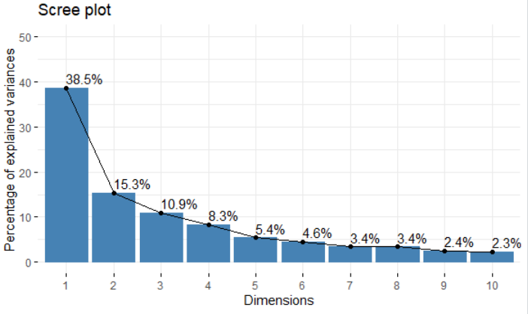
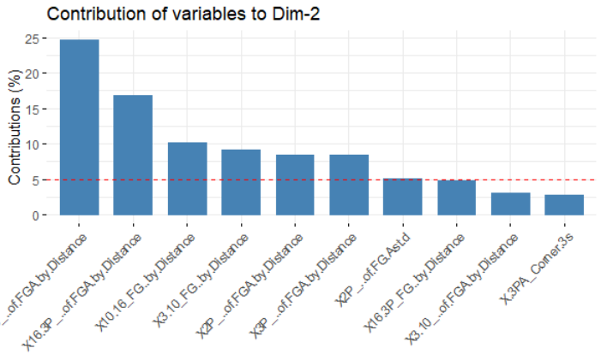
PCA

Slide 10
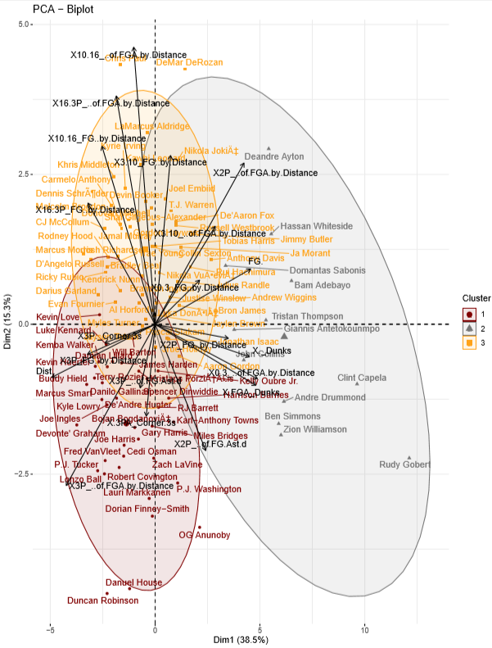
PCA

Slide 11
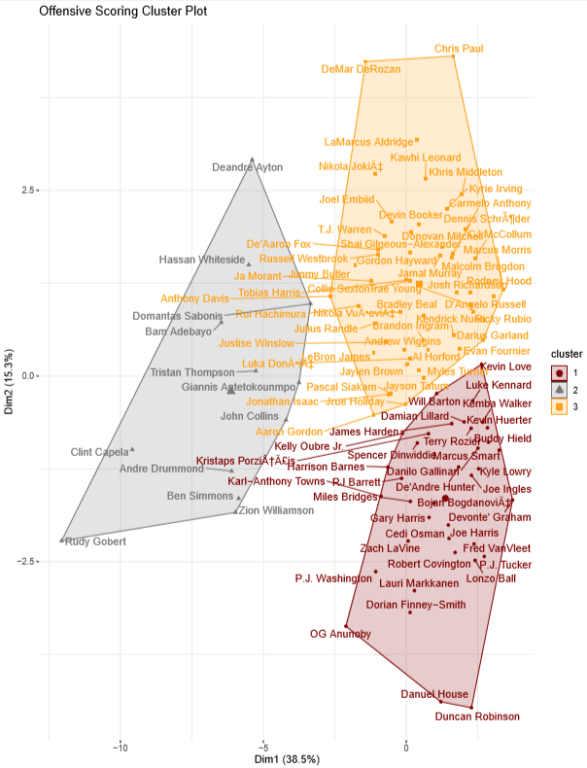
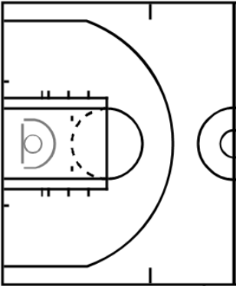
Cluster 1
Cluster 2
Cluster 3

Slide 12
Cluster Outcomes
Cluster 1 - Name
Cluster 2 - Name
Cluster 3 - Name
Describe playing style of cluster
Describe playing style of cluster
Describe playing style of cluster
Table with significant variables
Table with significant variables
Table with significant variables

Slide 13
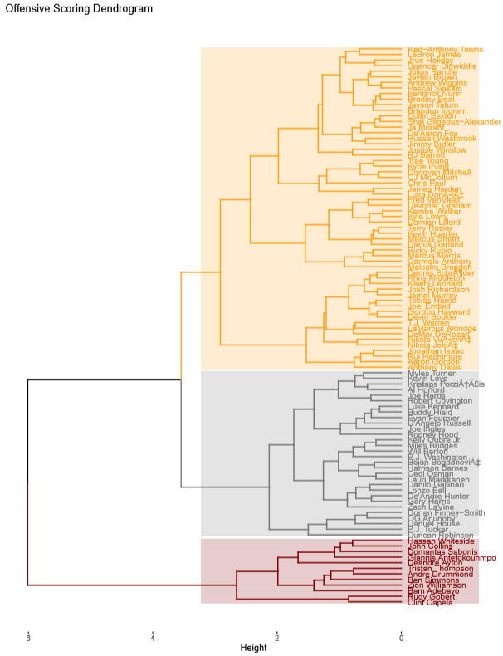
Compare/contrast to k means

Slide 14
Conclusions

Slide 15
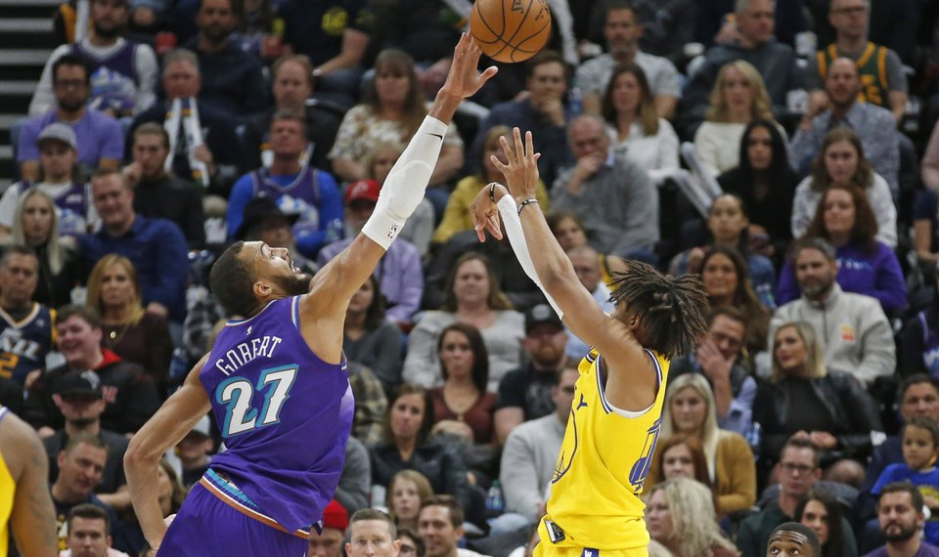
Defensive Performance Clusters

Slide 16
Data Description
Variables – what is it – list out
Then
Note which variables used/removed/subset/data cleaning

Slide 17
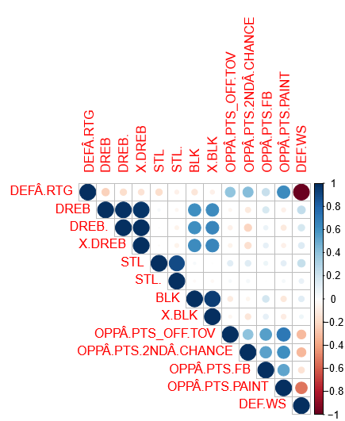
Corrplot
Takeaways
Takeaways

Slide 18
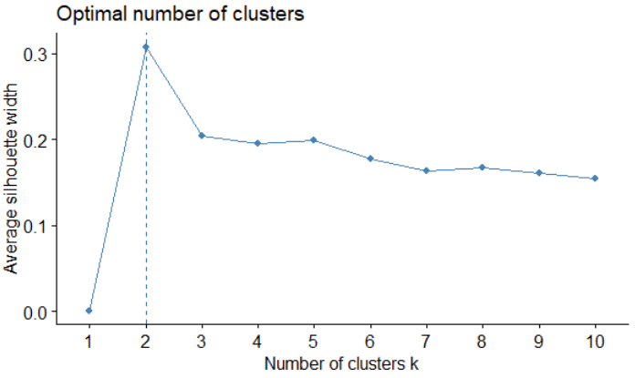
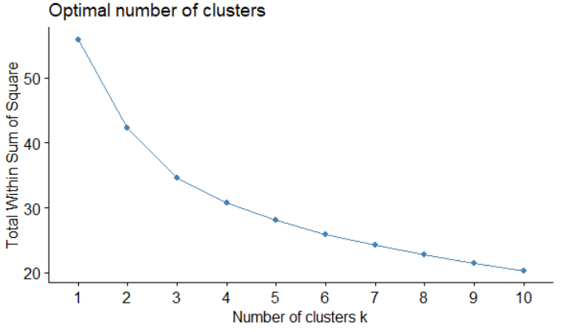
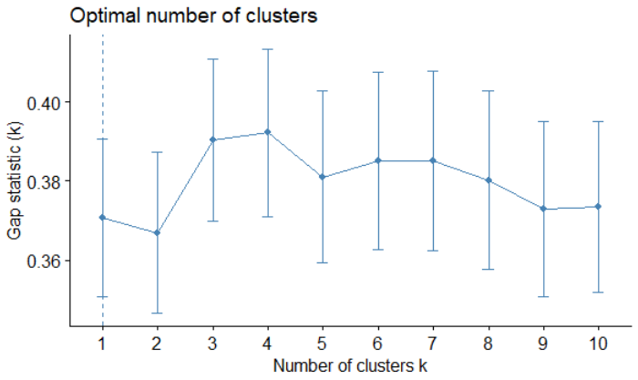
Cluster Outputs
Determine which cluster size to use …
Tagish line – describe different methods
Elbow Method
Silhouette Method
Gap Statistic Method
What is it/why used
What is it/why used
What is it/why used
Total clusters and why----

Slide 19
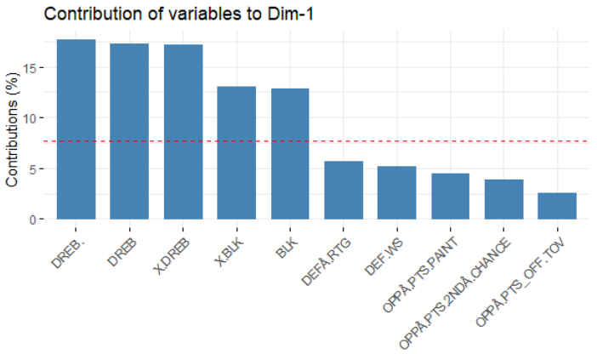
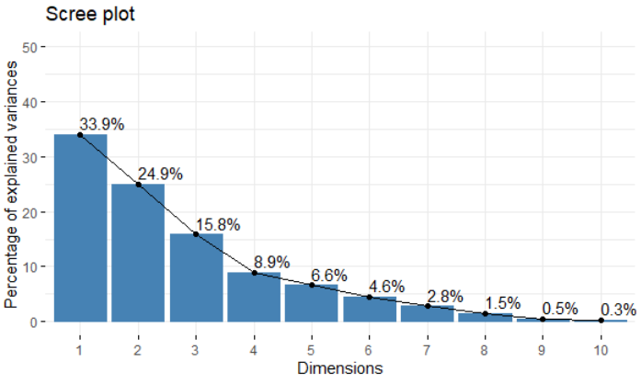
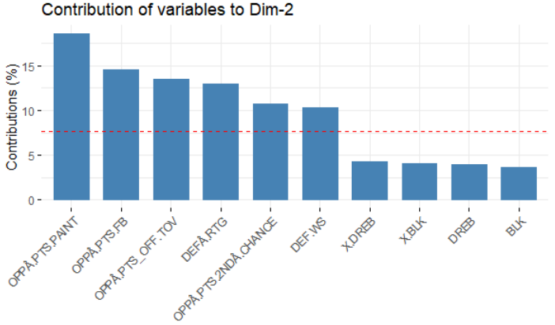
PCA

Slide 20
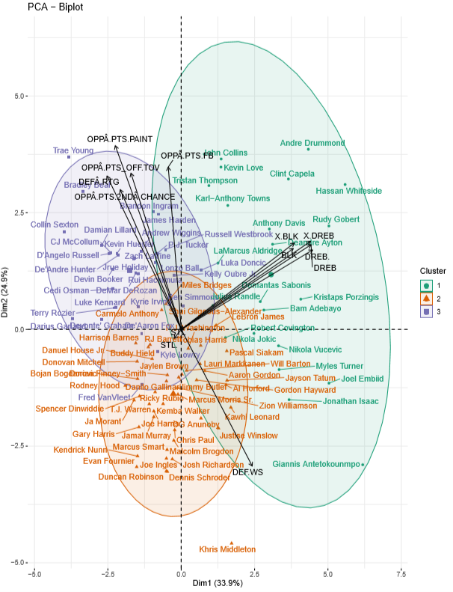
PCA

Slide 21
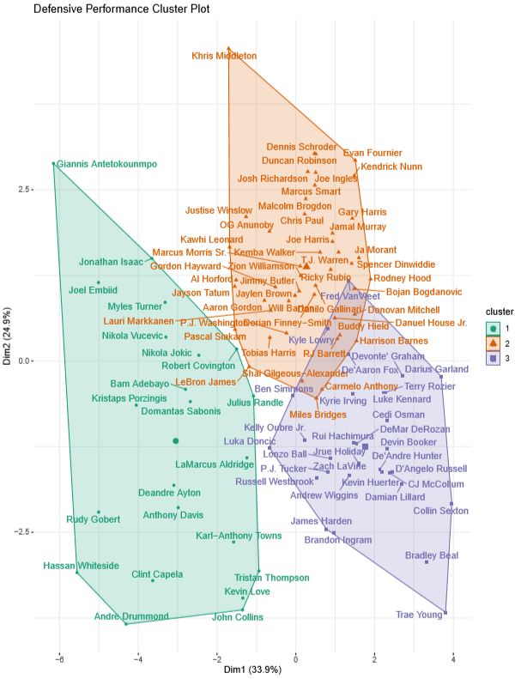
Cluster 1
Cluster 2
Cluster 3

Slide 22
Cluster Outcomes
Cluster 1 - Name
Cluster 2 - Name
Cluster 3 - Name
Describe playing style of cluster
Describe playing style of cluster
Describe playing style of cluster
Table with significant variables
Table with significant variables
Table with significant variables

Slide 23
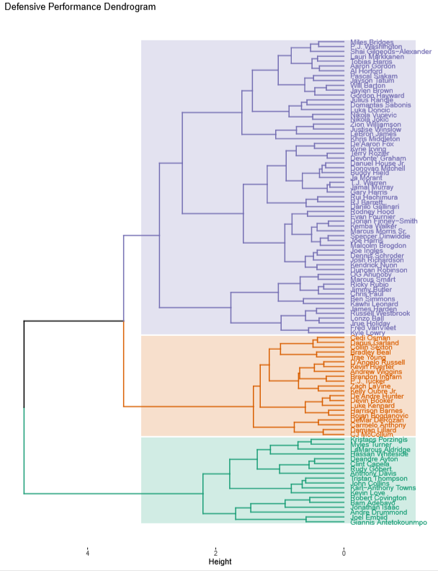
Compare/contrast to k means

Slide 24
Conclusions

Slide 25
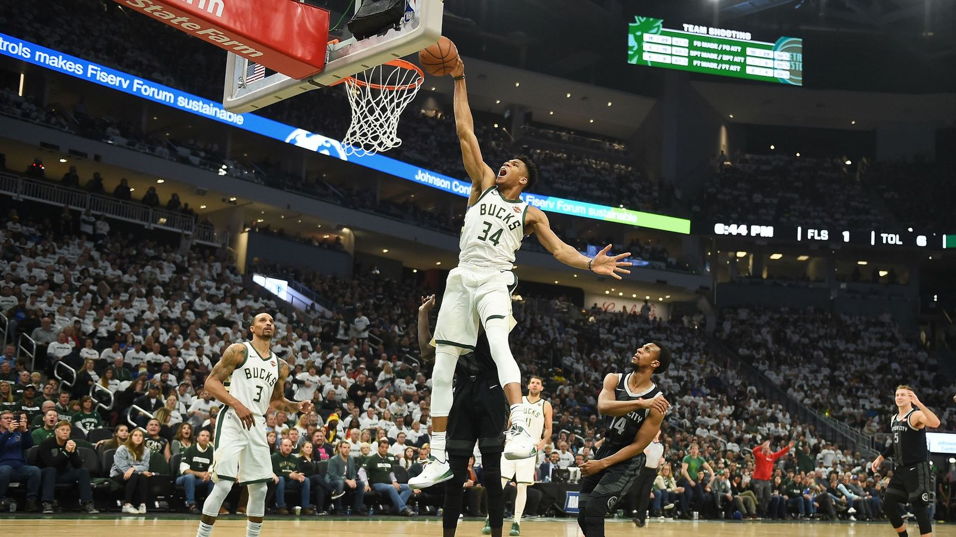
Overall Performance Clusters

Slide 26
Data Description
Variables – what is it – list out
Then
Note which variables used/removed/subset/data cleaning

Slide 27
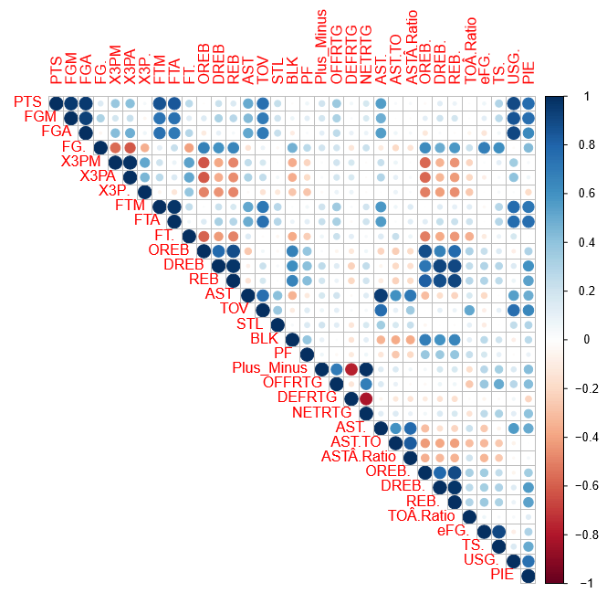
Corrplot
Takeaways
Takeaways

Slide 28
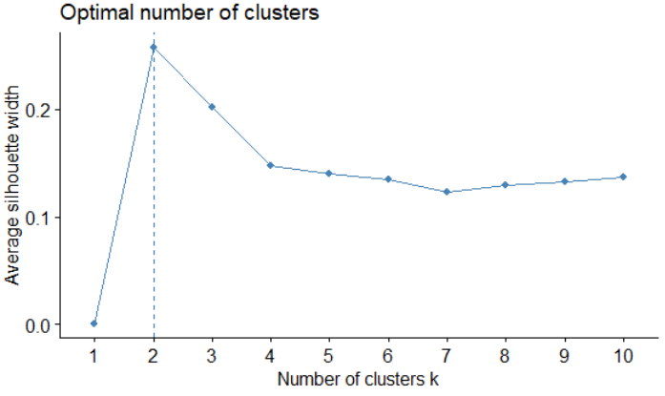
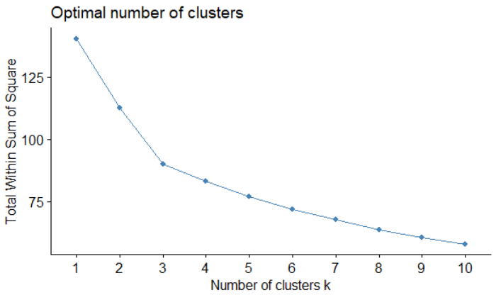
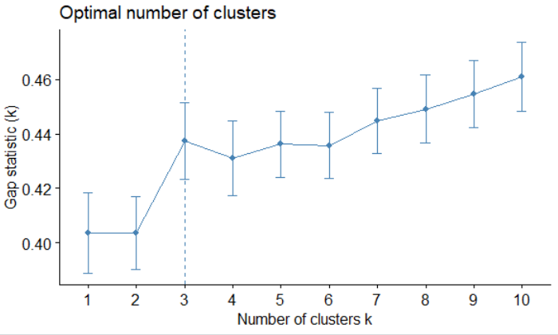
Cluster Outputs
Determine which cluster size to use …
Tagish line – describe different methods
Elbow Method
Silhouette Method
Gap Statistic Method
Total clusters and why----

Slide 29
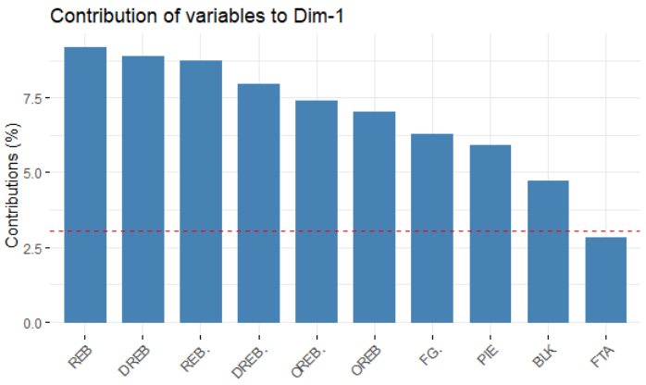
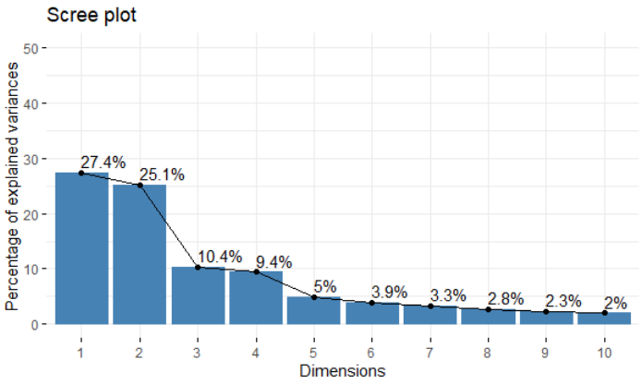
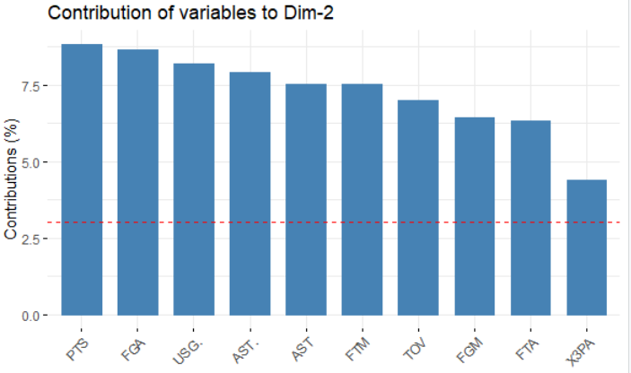
PCA

Slide 30
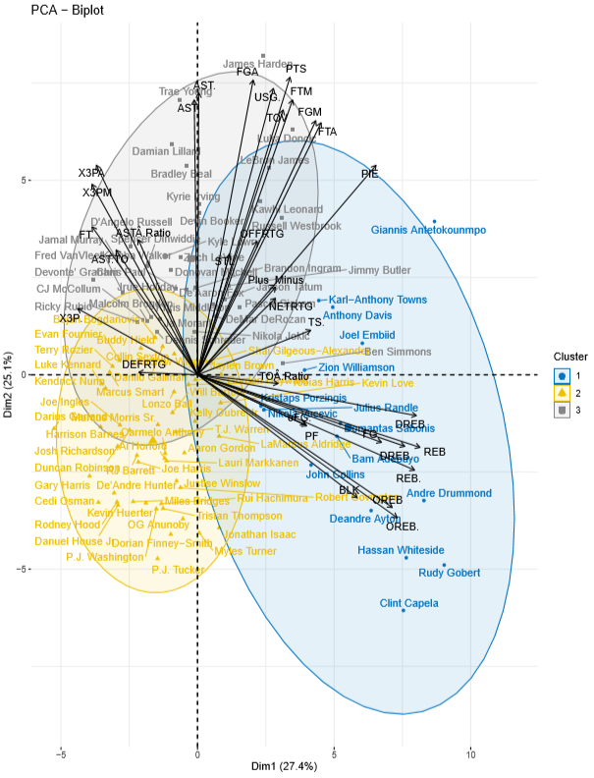
PCA

Slide 31
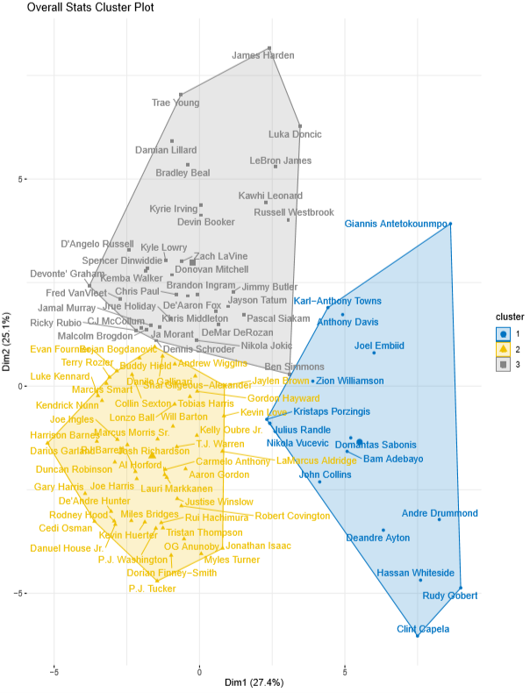
Cluster 1
Cluster 2
Cluster 3

Slide 32
Cluster Outcomes
Cluster 1 - Name
Cluster 2 - Name
Cluster 3 - Name
Describe playing style of cluster
Describe playing style of cluster
Describe playing style of cluster
Table with significant variables
Table with significant variables
Table with significant variables

Slide 33
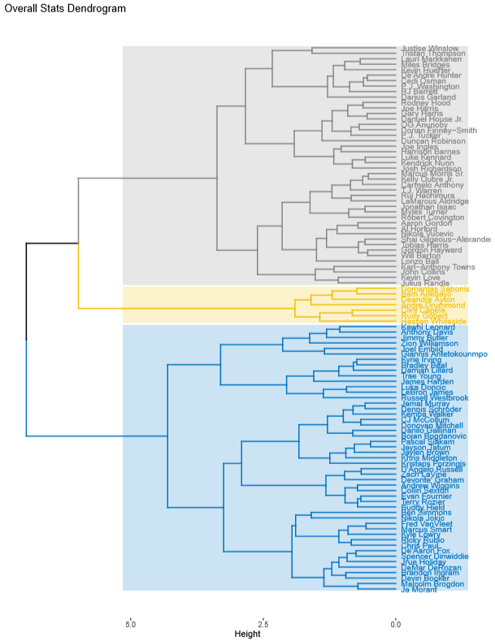
Compare/contrast to k means

Slide 34
Conclusions

Slide 35
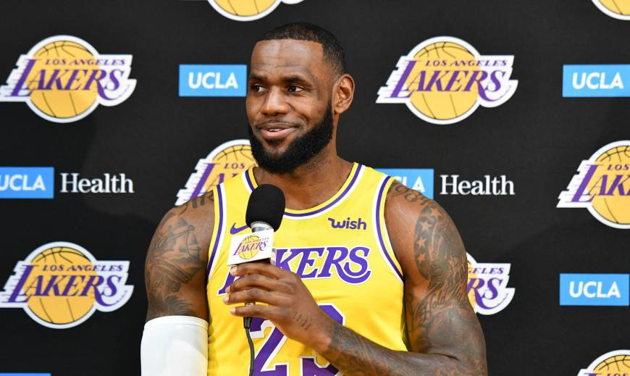
Conclusion

Slide 36
Pros/Cons
K means
HCA
PCA

Slide 37
Final Project Conclusions
1
2
3
4
5
6

Slide 38

The End
Questions?

Slide 39
References
All NBA pictures in deck found in ‘Images’ section on Google.com

Slide 40
Appendix transition slide
Locker room photo

Slide 41
Tables with cluster data output - offense
Show as heatmap table

Slide 42
Tables with cluster data output - defense
Show as heatmap table

Slide 43
Tables with cluster data output - overall
Show as heatmap table

Slide 44
Delete slides below

Slide 45
Agenda
1
Introduction
2
Offensive Scoring
3
Defense Performance
4
Overall Stats
5
Conclusion

Slide 46
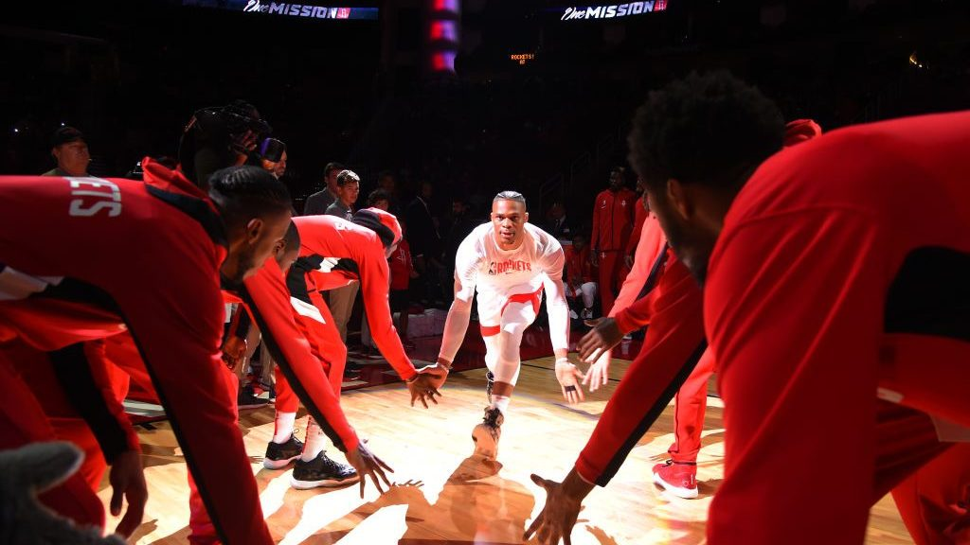
Necessary?
Introduction

